Slide 1
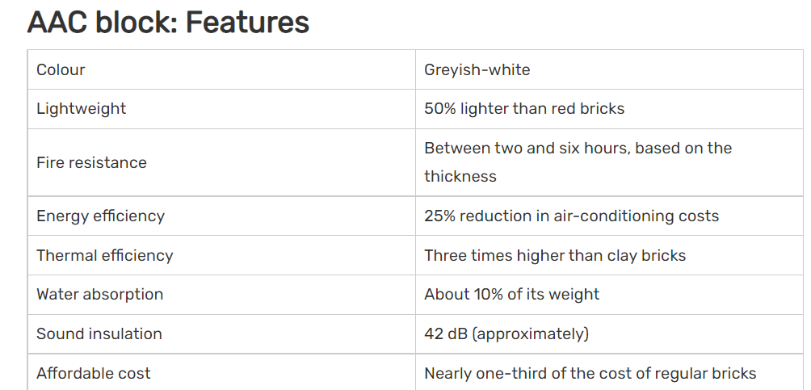
AAC Blocks
AAC blocks are also known as autoclaved aerated concrete blocks, which are one of the environment friendly and lightweight construction materials.
AAC blocks are a precast, foam concrete, sustainable construction material made from aggregates of quartz sand, calcined gypsum, lime, Portland cement, water and aluminum powder.
AAC block is used as a construction material for interior and exterior structures. The blocks may be coated with a stucco finish or with siding materials like veneer brick or vinyl siding.

Slide 2
AAC block price: AAC blocks sizes and prices
Manufacturers of autoclaved aerated concrete produce AAC blocks ranging in varied sizes and strengths. The AAC block price for rectangular AAC bricks having size (length X height X weight) of 600mm x 200mm x 250mm can range between Rs 2,000 and Rs 3,500 per cubic meter. The AAC blocks sizes and prices differ, depending on the manufacturer.
AAC blocks shapes :
Lintel blocks, which are also referred to as U-shaped bond beam are available in thickness of 8, 10, and 12 inches.
Tongue-and-groove AAC blocks or slabs are available in large sizes. These blocks are linked to adjacent units without the use of mortar at the vertical edges.
Cored blocks are used in building vertical reinforced grout cells.
AAC blocks advantages :
1. Eco-Friendly and Sustainable
2. Lightweight
3. Thermally Insulated & Energy Efficient
4. Fire Resistant
5. Acoustic Performance
6. Easy Workability and Design Flexibility
7. Seismic Resistant
8. Faster Construction

Slide 3
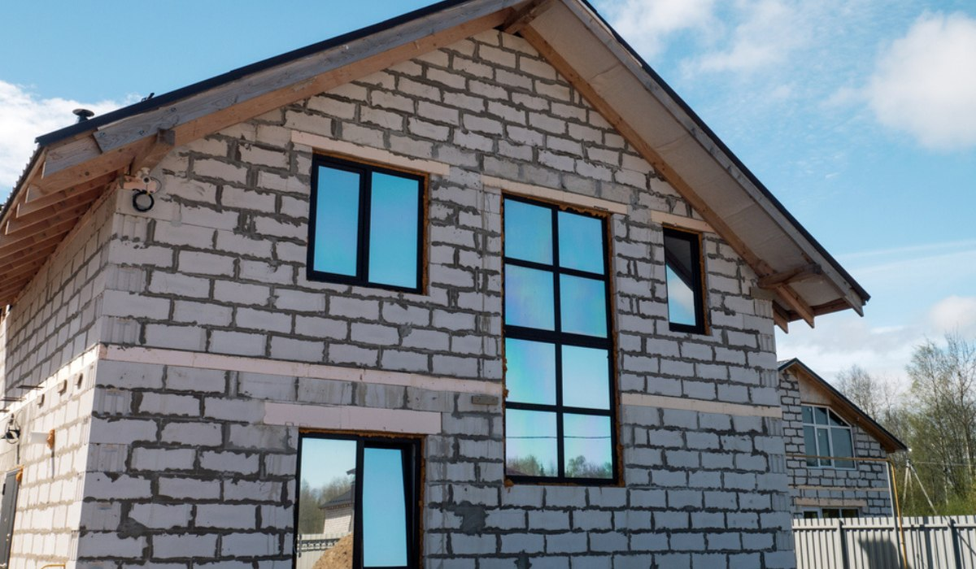
AAC Block Uses:
AAC blocks are widely used in the construction of apartments and other types of residential properties, industrial and commercial buildings, such as hotels, offices, hospitals and schools. Owing to their excellent heat insulation capacity, AAC bricks find application in interior and exterior construction. They are ideal for high-rise structures.
Properties of AAC Block:
Oven - dry density is 552 to 650 kg/cum
Compressive strength is 35 to 40 kg/cm2 as per is code 2185
Thermal resistance is 0.8 to 1.25 per inch of thickness

Slide 4

